Slide 1
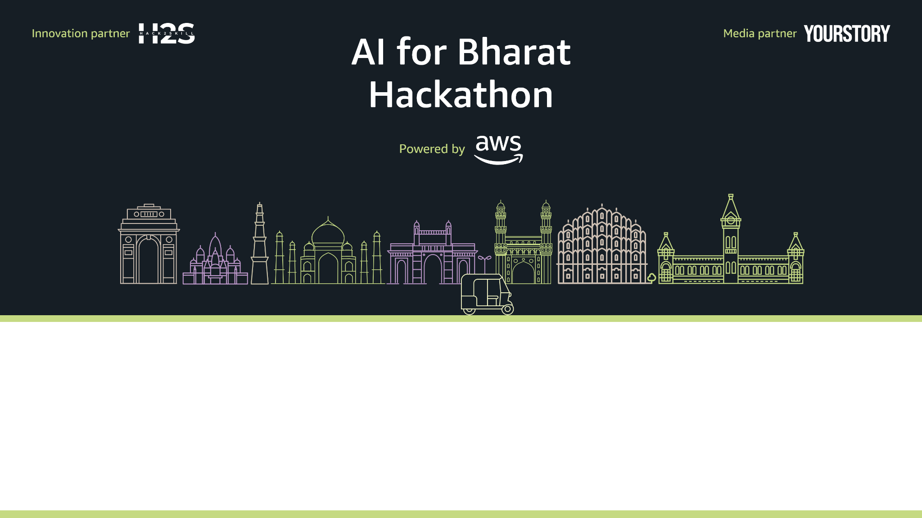
Team Name : Gram-Setu
Team Leader Name : Archa Vivek
Problem Statement : AI for Communities, Access & Public Impact [Problem 6]

Slide 2
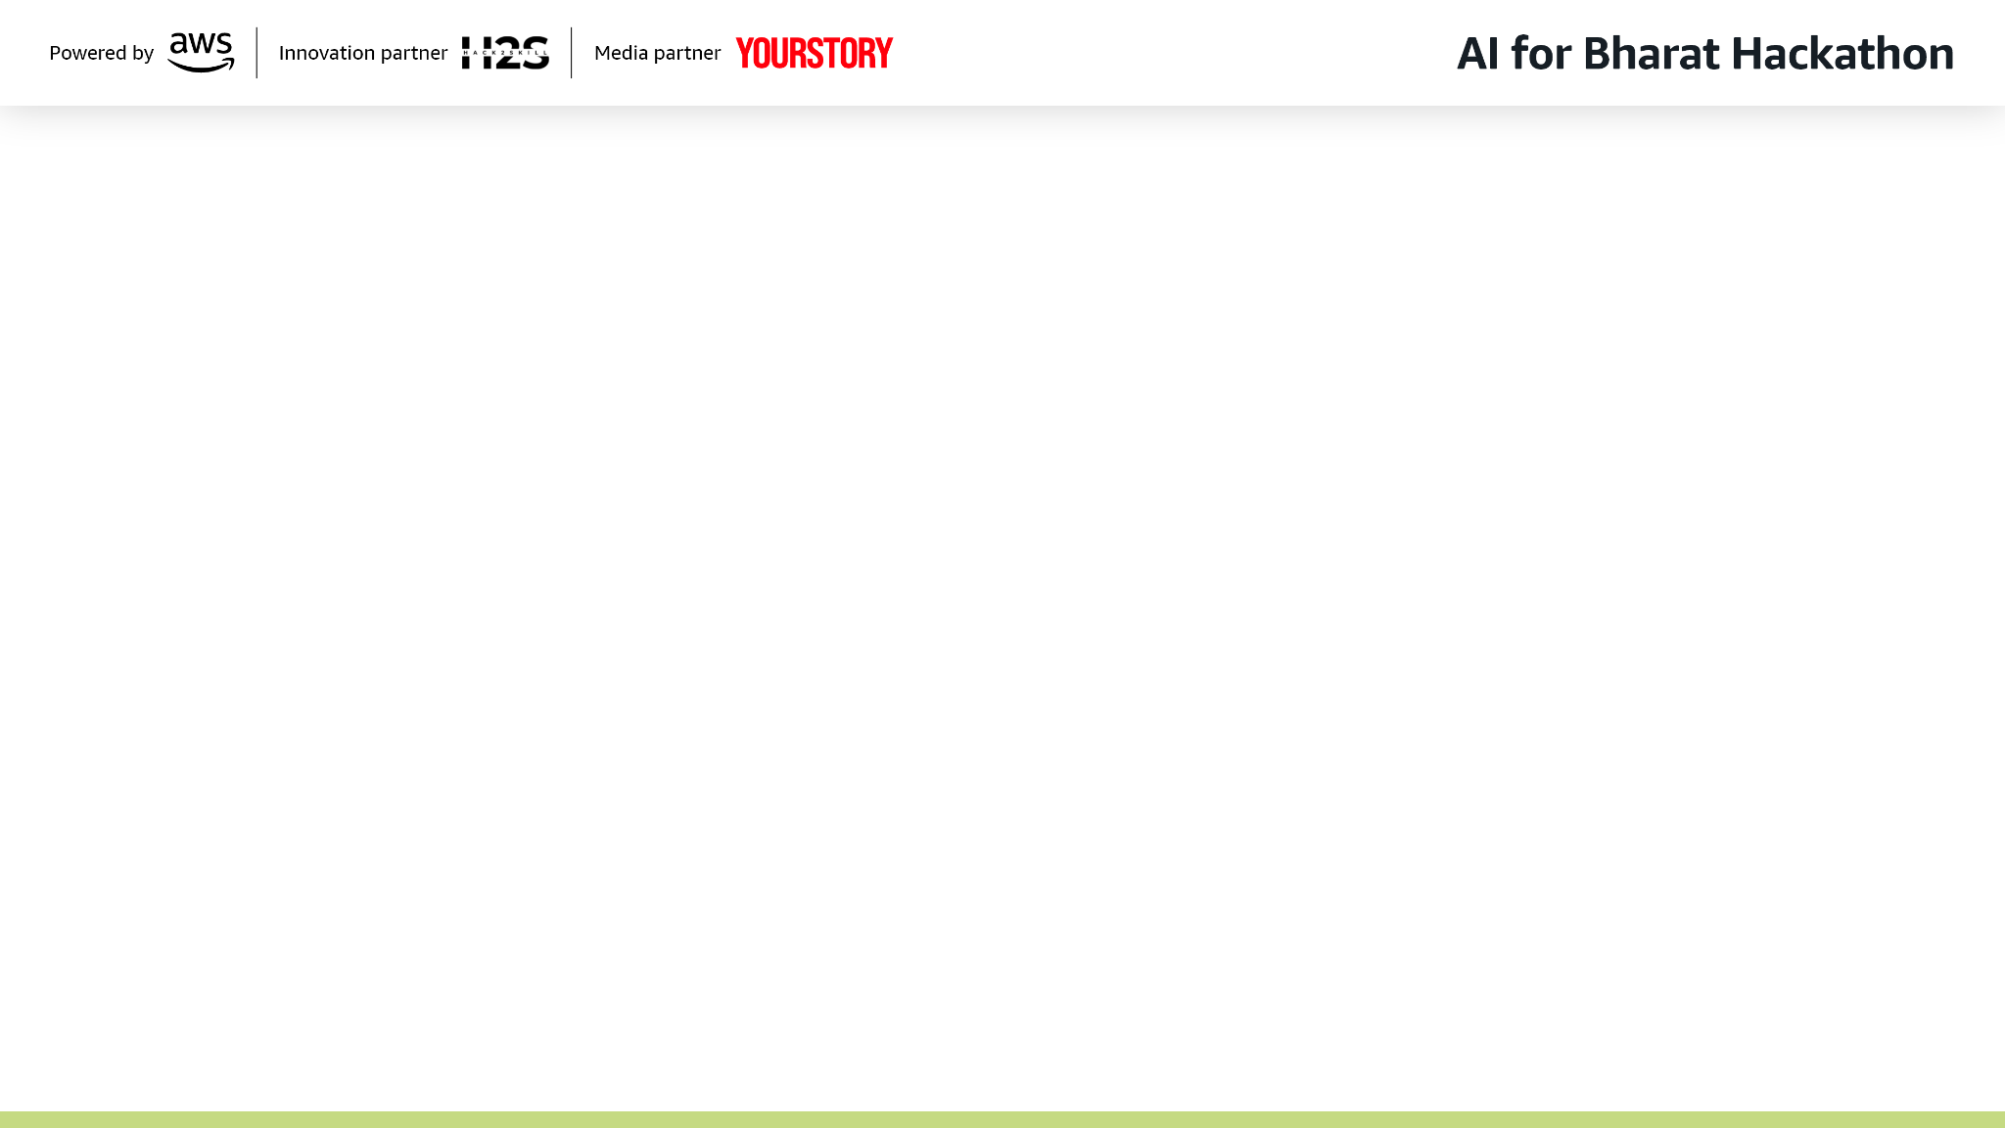
Brief about the Idea:
"Bridging the Gap Between Governance and the Grassroots."
Nagrik-Sahayak is an AI-powered, voice-first mobile application designed for rural Indian citizens. It acts as a personal assistant that listens to users in their native dialect, searches through complex government scheme documents, and explains benefits and eligibility in simple, spoken language.
It solves the three biggest barriers to access: Literacy, Language, and Connectivity.

Slide 3
Your solution should be able to explain the following:
How different is it from any of the other existing ideas?
Most apps are text-based or just translate static pages. Nagrik-Sahayak uses Generative AI to have a conversation. It doesn't just show a PDF; it reads it, understands it, and answers specific questions like “Am I eligible if I own 2 acres of land?”
How will it be able to solve the problem?
It uses Bhashini API for accurate Indian language processing and RAG (Retrieval Augmented Generation) to ensure answers are factually correct based only on official government documents.
USP of the proposed solution
1. Voice-First Interface: No typing required
2. Hyper-Local: Supports dialects via Bhashini.
3. Offline-Ready: Works as a PWA (Progressive Web App) even with spotty internet.

Slide 4
List of features offered by the solution
1. Multilingual Voice Interaction: Speaks and listens in 10+ Indian languages (Hindi, Tamil, Telugu, etc.).
2. Smart Eligibility Check: AI asks follow-up questions to determine if a user qualifies for a scheme.
3. Zero-Hallucination Guarantee: Uses a Strict RAG pipeline to ensure advice comes strictly from official documents.
4. Offline Mode: Caches recent schemes and queues queries when the internet is down.
5. Application Guide: Provides step-by-step audio instructions on how to fill out forms.

Slide 5
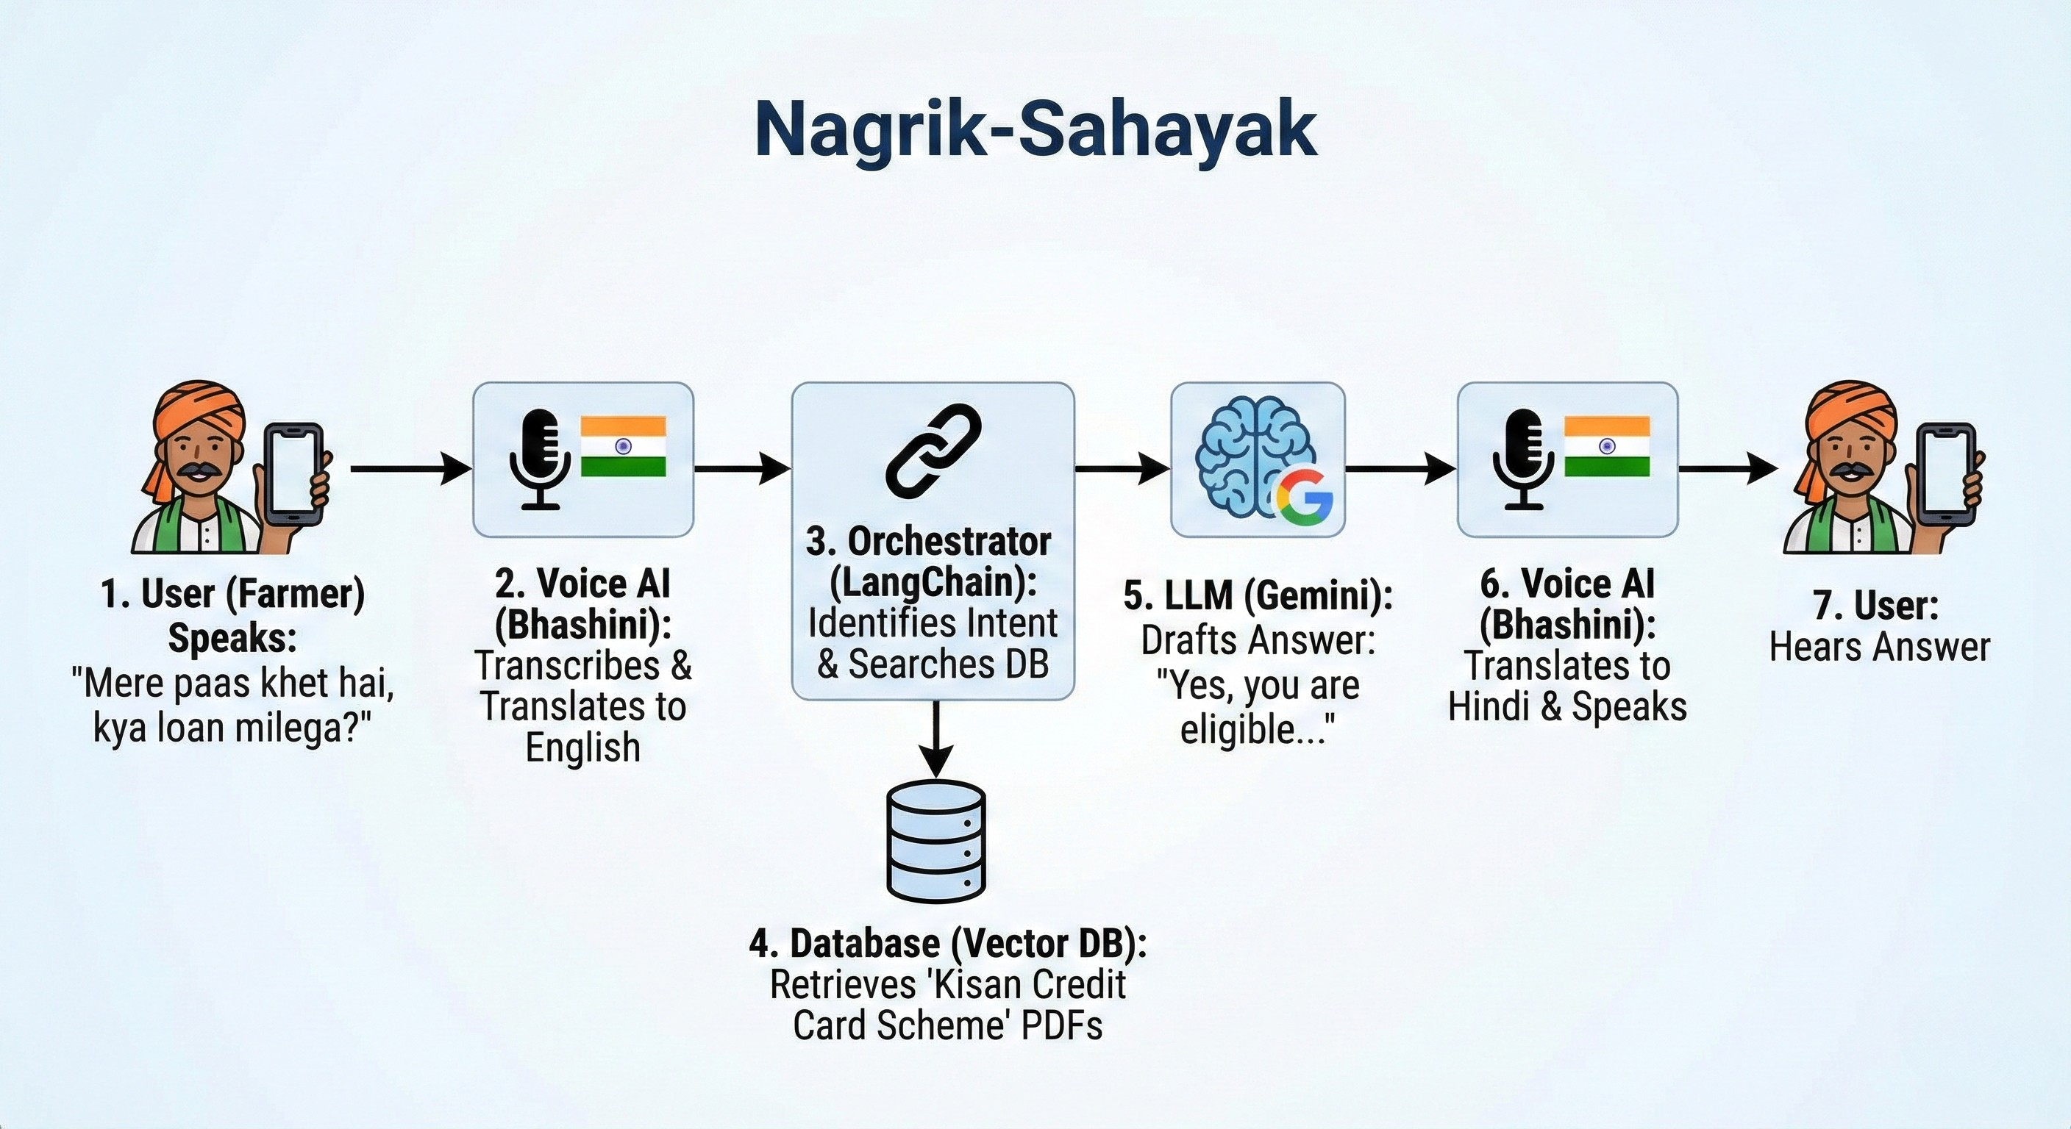
Process flow diagram or Use-case diagram

Slide 6
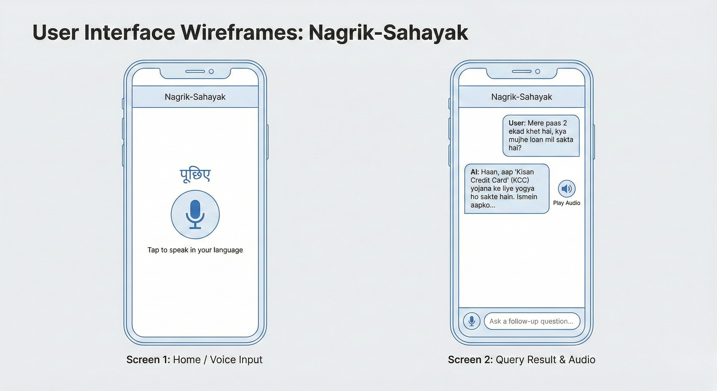
Wireframes/Mock diagrams of the proposed solution (optional)

Slide 7
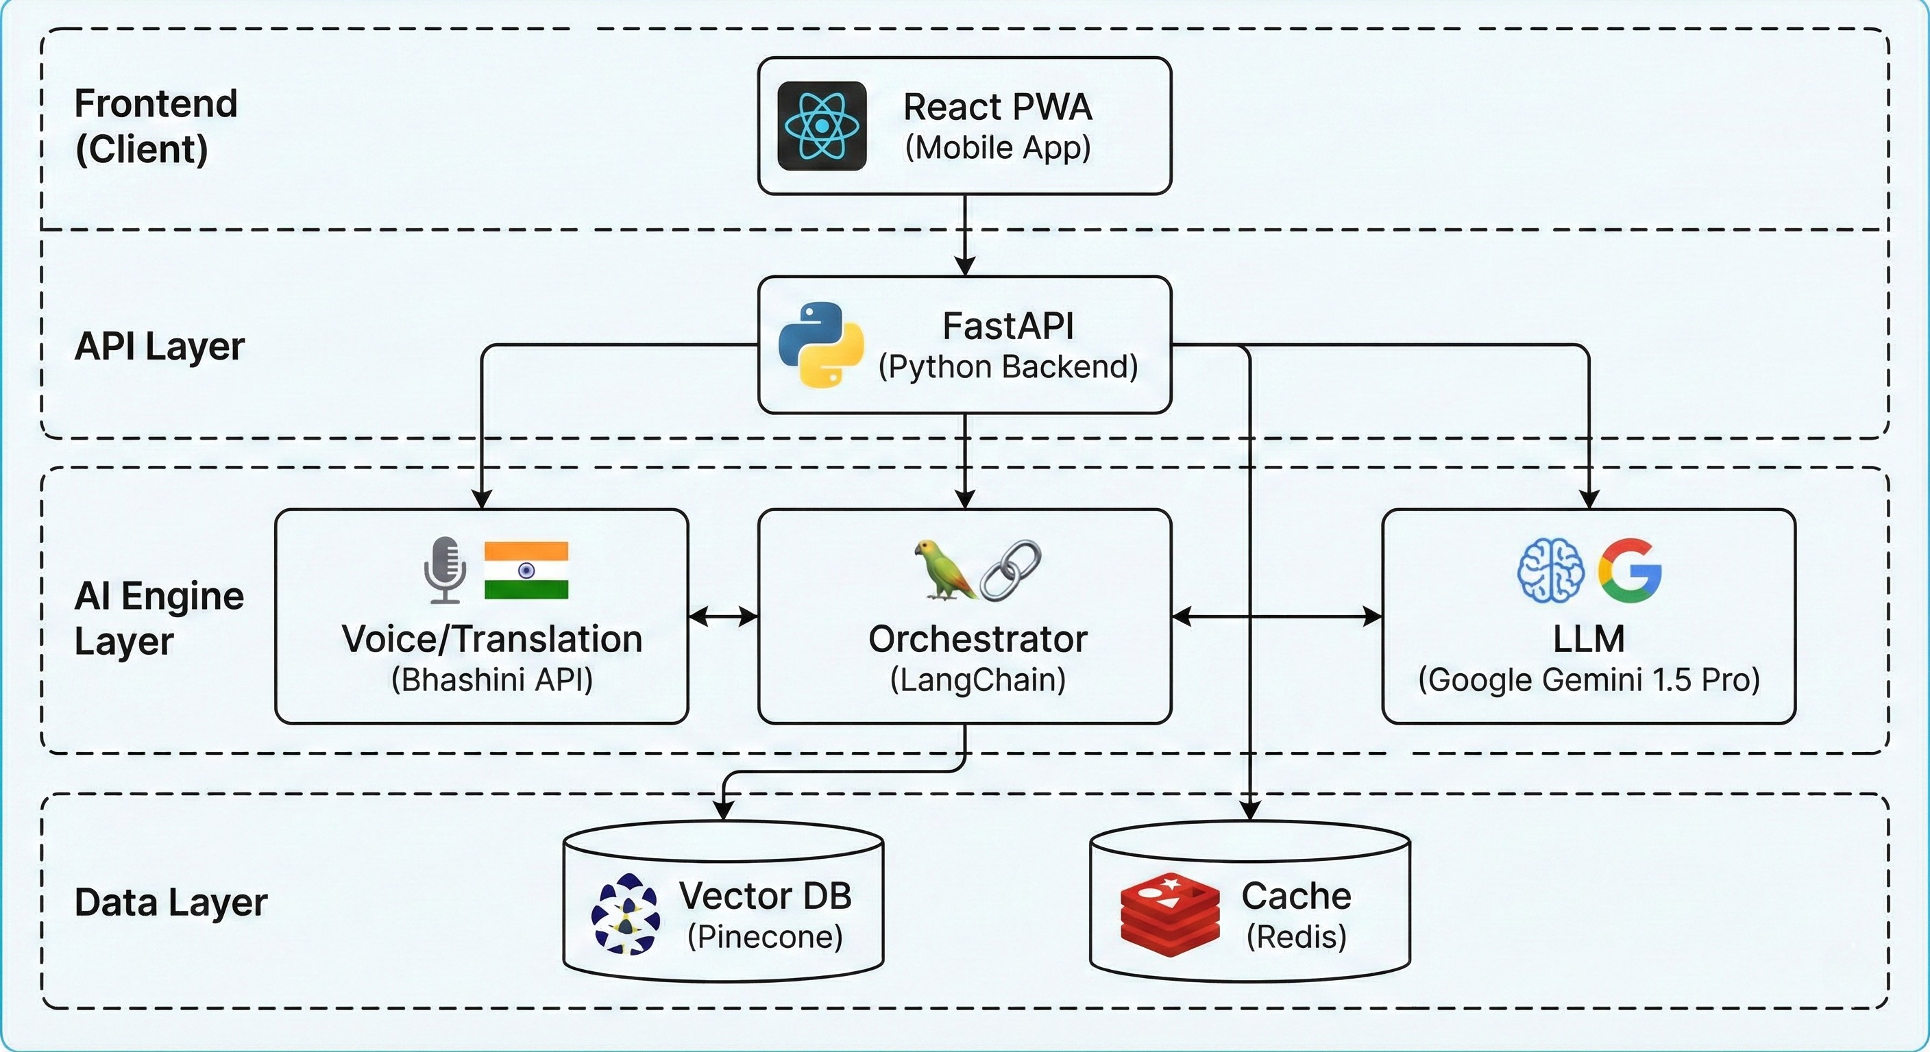
Architecture diagram of the proposed solution:

Slide 8
Technologies to be used in the solution:
1. Core AI: Google Gemini 1.5 Pro (Reasoning), Bhashini API (Voice & Translation).
2. Backend: Python, FastAPI, LangChain.
3. Frontend: React.js, Tailwind CSS.
4. Database: Pinecone (Vector Search), PostgreSQL (Metadata).
5. DevOps: Docker, AWS Cloud.

Slide 9
Estimated implementation cost (optional):
-> Development: Open-Source Tools (Free).
-> Hosting (MVP):
1. Backend (AWS Free Tier): $0
2. Database (Pinecone Free Tier): $0
3. LLM API (Gemini Free Tier): $0
-> Total Monthly Cost (MVP): $0 (Free)
-> Scale-up Cost: ~$50/month for 10,000 users.

Slide 10
Add as per the requirements for the hackathon:
1. GitHub Repository: [https://github.com/Thorcha-Errox/AI-For-Bharat]
2. Files Included: requirements.md and design.md (Generated via Kiro).
3. Presentation: This Deck.
4. Kiro Usage: Specs generated using Kiro AI as per instructions.

Slide 11
